Slide 1
Video Editor Portfolio
STUDENT NAME: S.KARTHI
REGISTER NO AND NMID: 2422K1940 & asbru062422k1940
DEPARTMENT: B.Sc CS
COLLEGE: CHIKKANNA GOVT ARTS AND SCIENCE COLLEGE
/BHARATHIYAR UNIVERSITY

Slide 2
PROJECT TITLE
PROJECT TITLE
“My Portfolio|Video Editor”
(A personal website showcasing my video editing projects and skills.)

Slide 3


AGENDA
Problem Statement
Project Overview
End Users
Tools and Technologies
Portfolio design and Layout
Features and Functionality
Results and Screenshots
Conclusion
Github Link
3/21/2024 Annual Review

Slide 4

PROBLEM STATEMENT
"Video editors often struggle to showcase their skills and projects in a structured and creative way . This project solves the problem by building a personal portfolio website for video editing works."

Slide 5

PROJECT OVERVIEW
"A responsive portfolio website created using HTML, CSS, and JavaScript,containing Home, About, Projects, and Contact sections. It highlights video editing works, skills, and contact details."

Slide 6

WHO ARE THE END USERS?
1.Recruiters / Employers
2.Clients looking for video editors
3.YouTube content creators
4.Social media influencers

Slide 7

TOOLS AND TECHNIQUES
1.HTML5 – for webpage structure
2.CSS3 – for styling and responsiveness
3.JavaScript – for interactivity (button actions)
4.Video Embeds – to showcase editing work

Slide 8
POTFOLIO DESIGN AND LAYOUT
1.Header with navigation (Home, About, Projects, Contact)
2.Hero Section with intro & call-to-action
3.About Section describing skills
4.Projects Section with videos & descriptions
5.Contact Section with email link
6.Footer with credits
8

Slide 9
FEATURES AND FUNCTIONALITY
1.Sticky navigation header
2.Responsive design
3.Video showcase cards with hover effect
4.Call-to-action buttons
5.Smooth layout for professional presentation

Slide 10
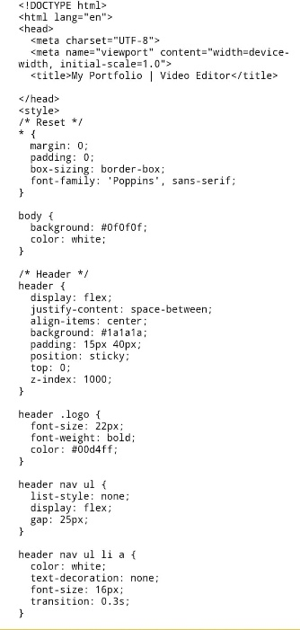
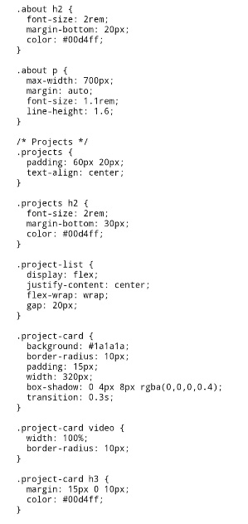
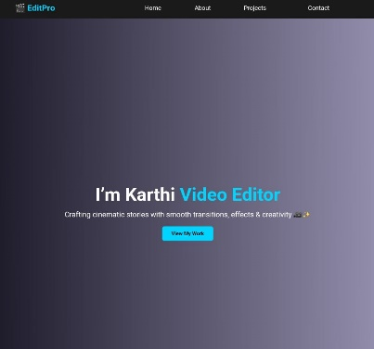
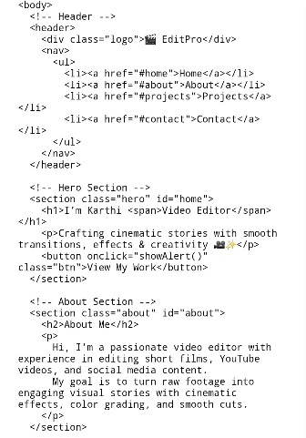
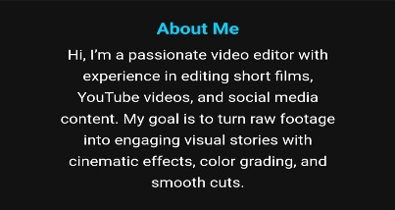
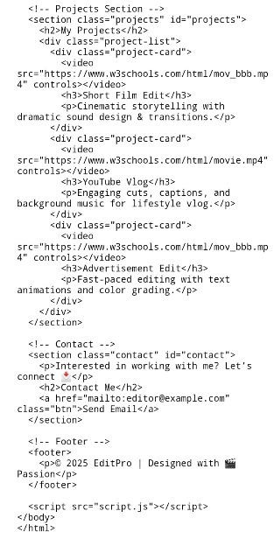
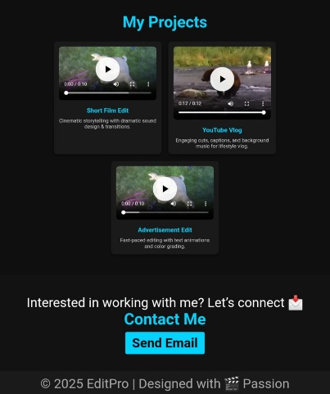

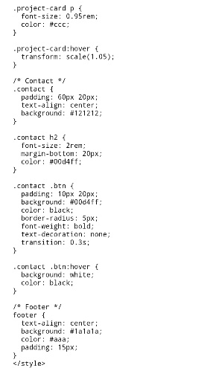
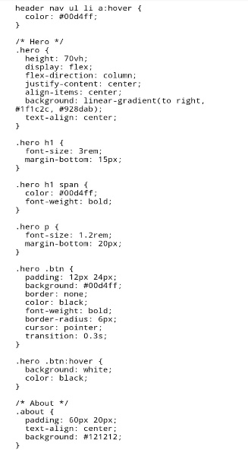
RESULTS AND SCREENSHOTS
HTML and CSS code
Output
10

Slide 11
CONCLUSION
"This project demonstrates how a simple website can be an effective digital portfolio for video editors.
It showcases creativity, skills, and professionalism in an interactive way."
11

